Slide 1




IPL 2024 Unveiled:
A Database Perspective

Slide 2
Presented By -
The Query Quokkas
Team Members -
Arnica Sarker (22201015)
Faria Khan (22201021)
Sukanta Chakraborty (22201022)
Marzan Ahmed (22201055)

Slide 3
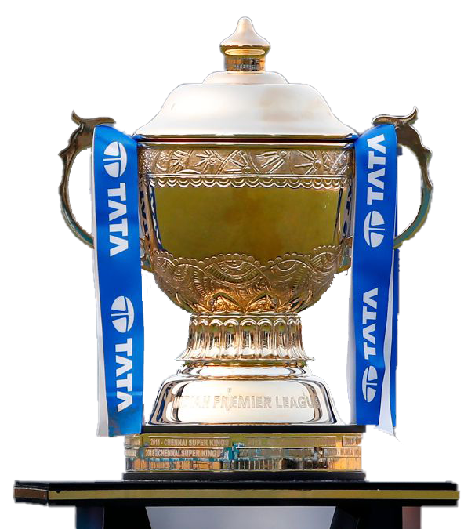
About
The IPL 2024 Database System organizes key tournament data, including stadiums, teams, players, matches, tickets & sponsorships.
It tracks schedules, results, ticket sales & facilities, ensuring efficient data handling and accurate operations. With interlinked tables, it simplifies managing teams, match summaries & points tables; supporting this season’s IPL activities seamlessly.

Slide 4
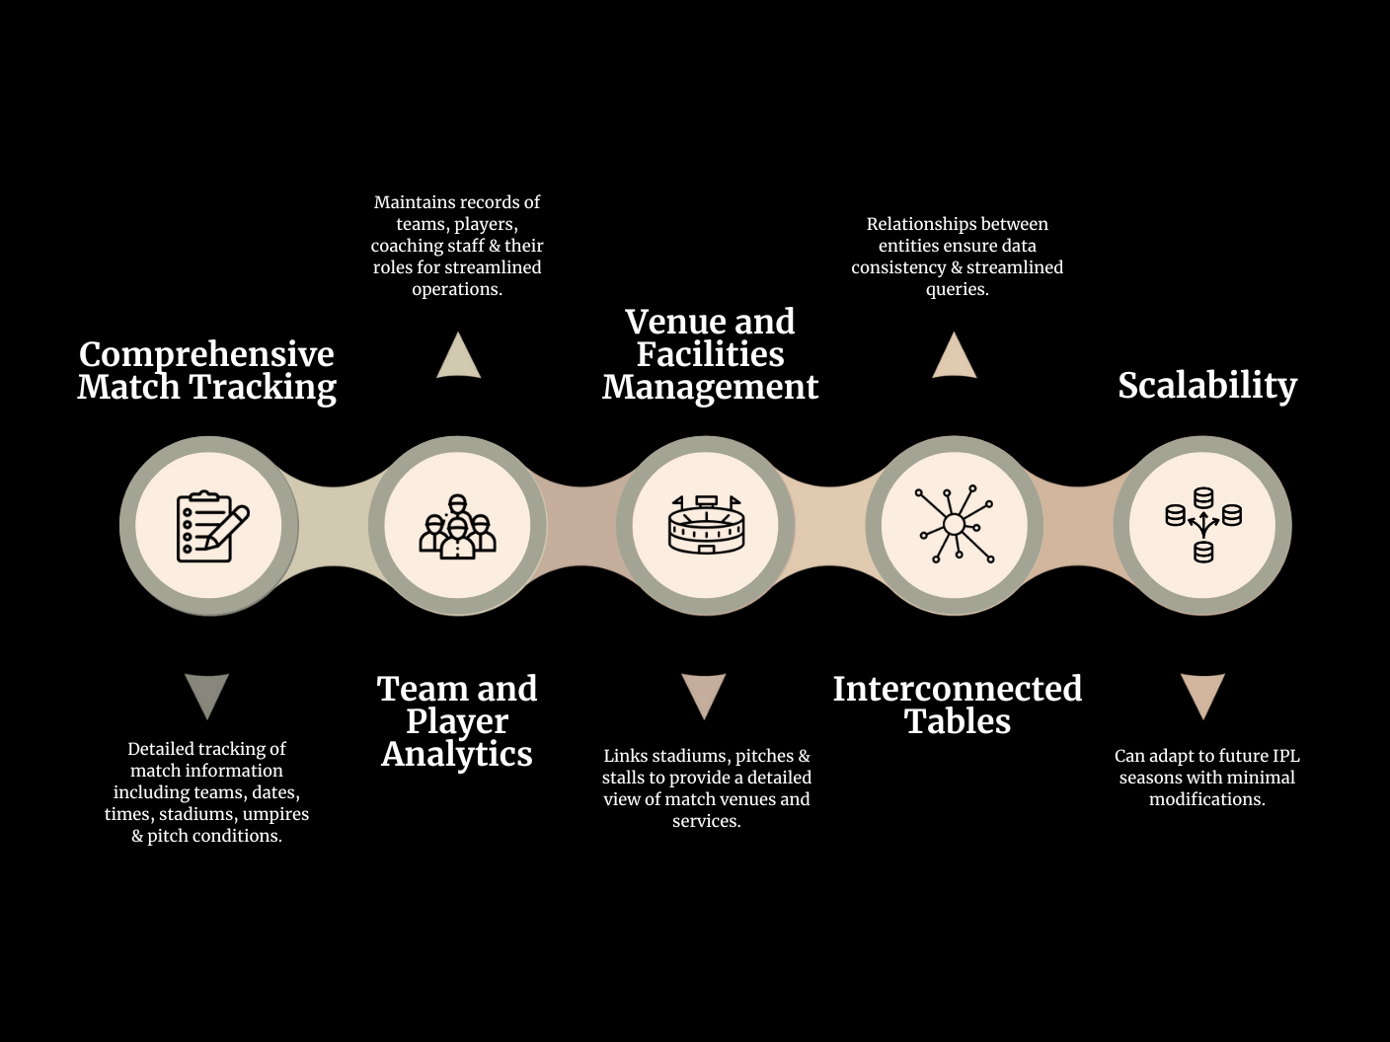

Key Features

Slide 5











Entities
1. Stadium
2. Team
3. Player
4. Coaching_Staff
5. Umpire
6. Pitch
7. Match_Info
8. Match_Summary
9. Sponsorship
10. Stall
11. Ticket

Slide 6
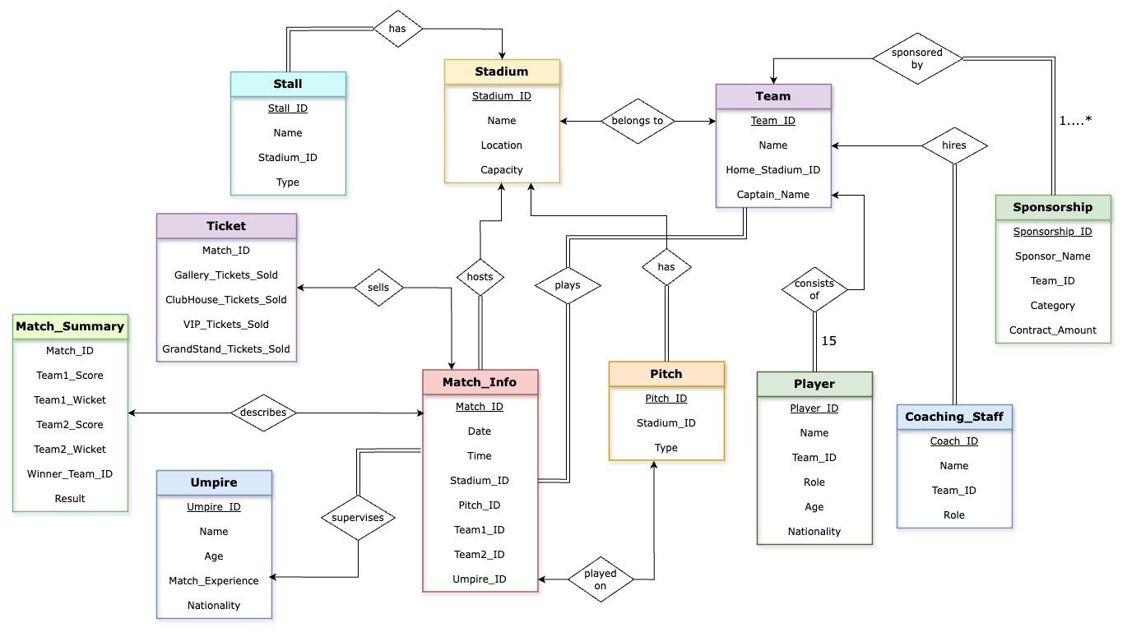
Entity Relationship Diagram
1. Stadium to Pitch → 1:N
2. Stadium to Stall → 1:N
3. Stadium to Team → 1:1
4. Stadium to Match_Info → 1:N
5. Team to Player → 1:N
6. Team to Coaching_Staff → 1:N
7. Team to Sponsorship → 1:N
8. Team to Match_Info → N:N
9. Umpire to Sponsorship → 1:N
10. Match_Info to Summary → 1:1
11. Pitch to Match_Info → 1:N
12. Match_info to Ticket → 1:1

Slide 7
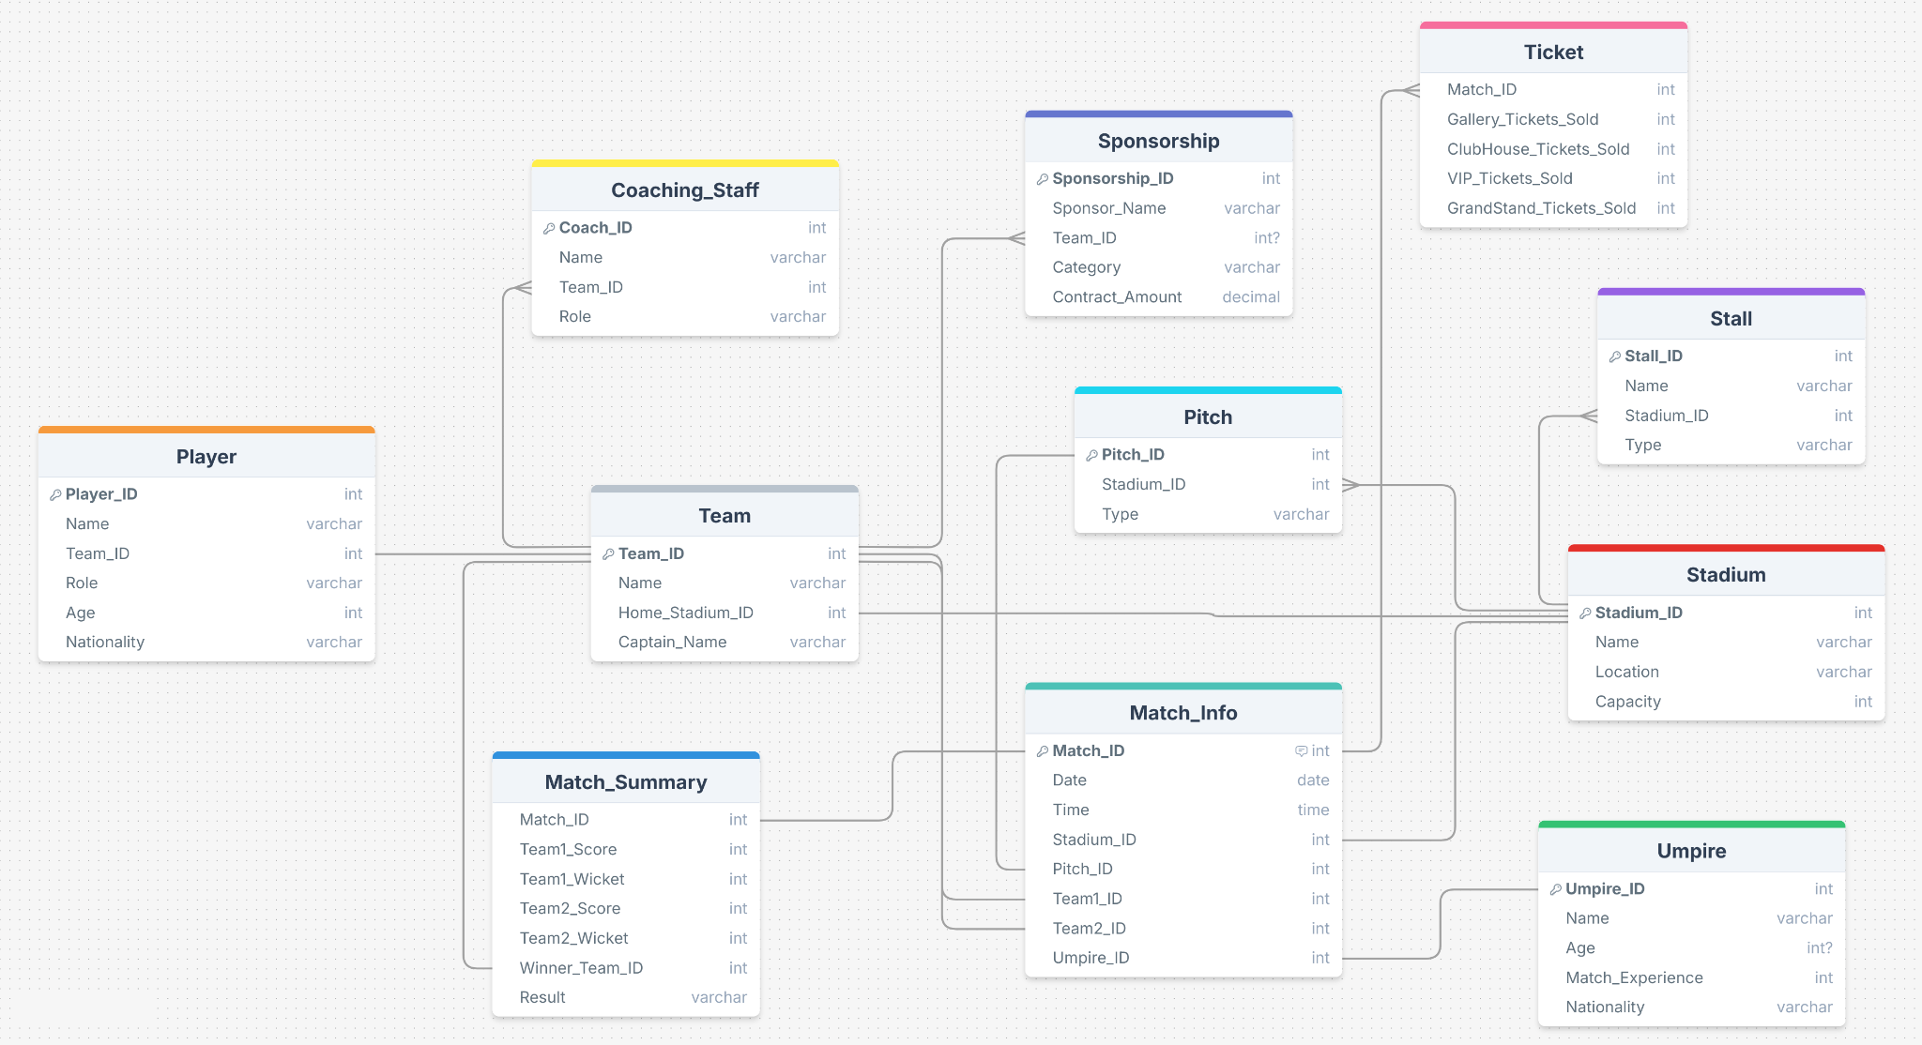
Schema Diagram

Slide 8
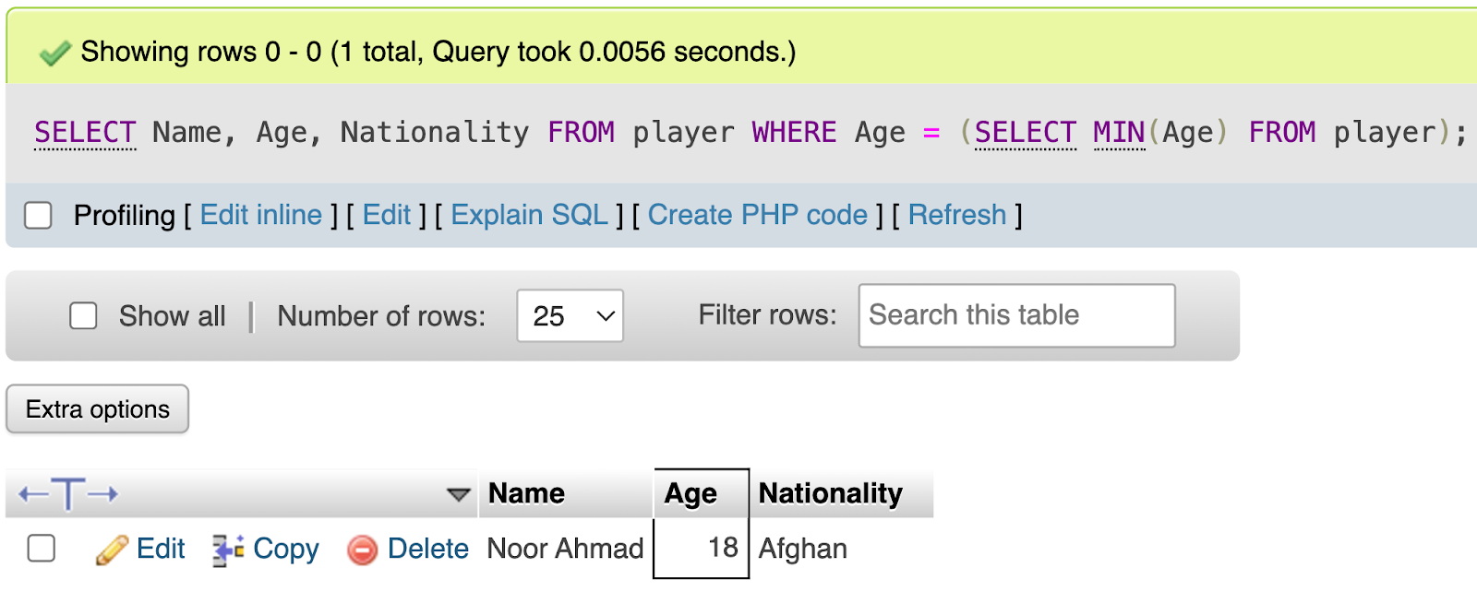
Database Operations
“Query #1”
Who is the youngest player of this IPL?
SELECT Name, Age, Nationality
FROM player
WHERE Age = (SELECT MIN(Age)
FROM player);

Slide 9
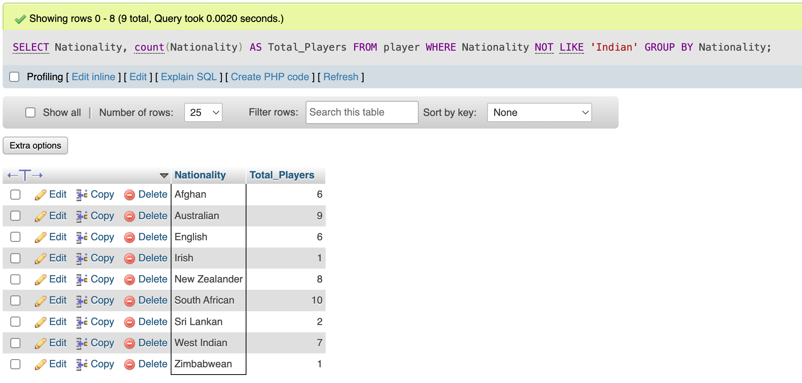
Database Operations
“Query #2”
List the nationalities of all foreign players along with the total number of players from each nationality.
SELECT Nationality, count(Nationality) AS Total_Player FROM player
WHERE Nationality NOT LIKE 'Indian'
GROUP BY Nationality;

Slide 10
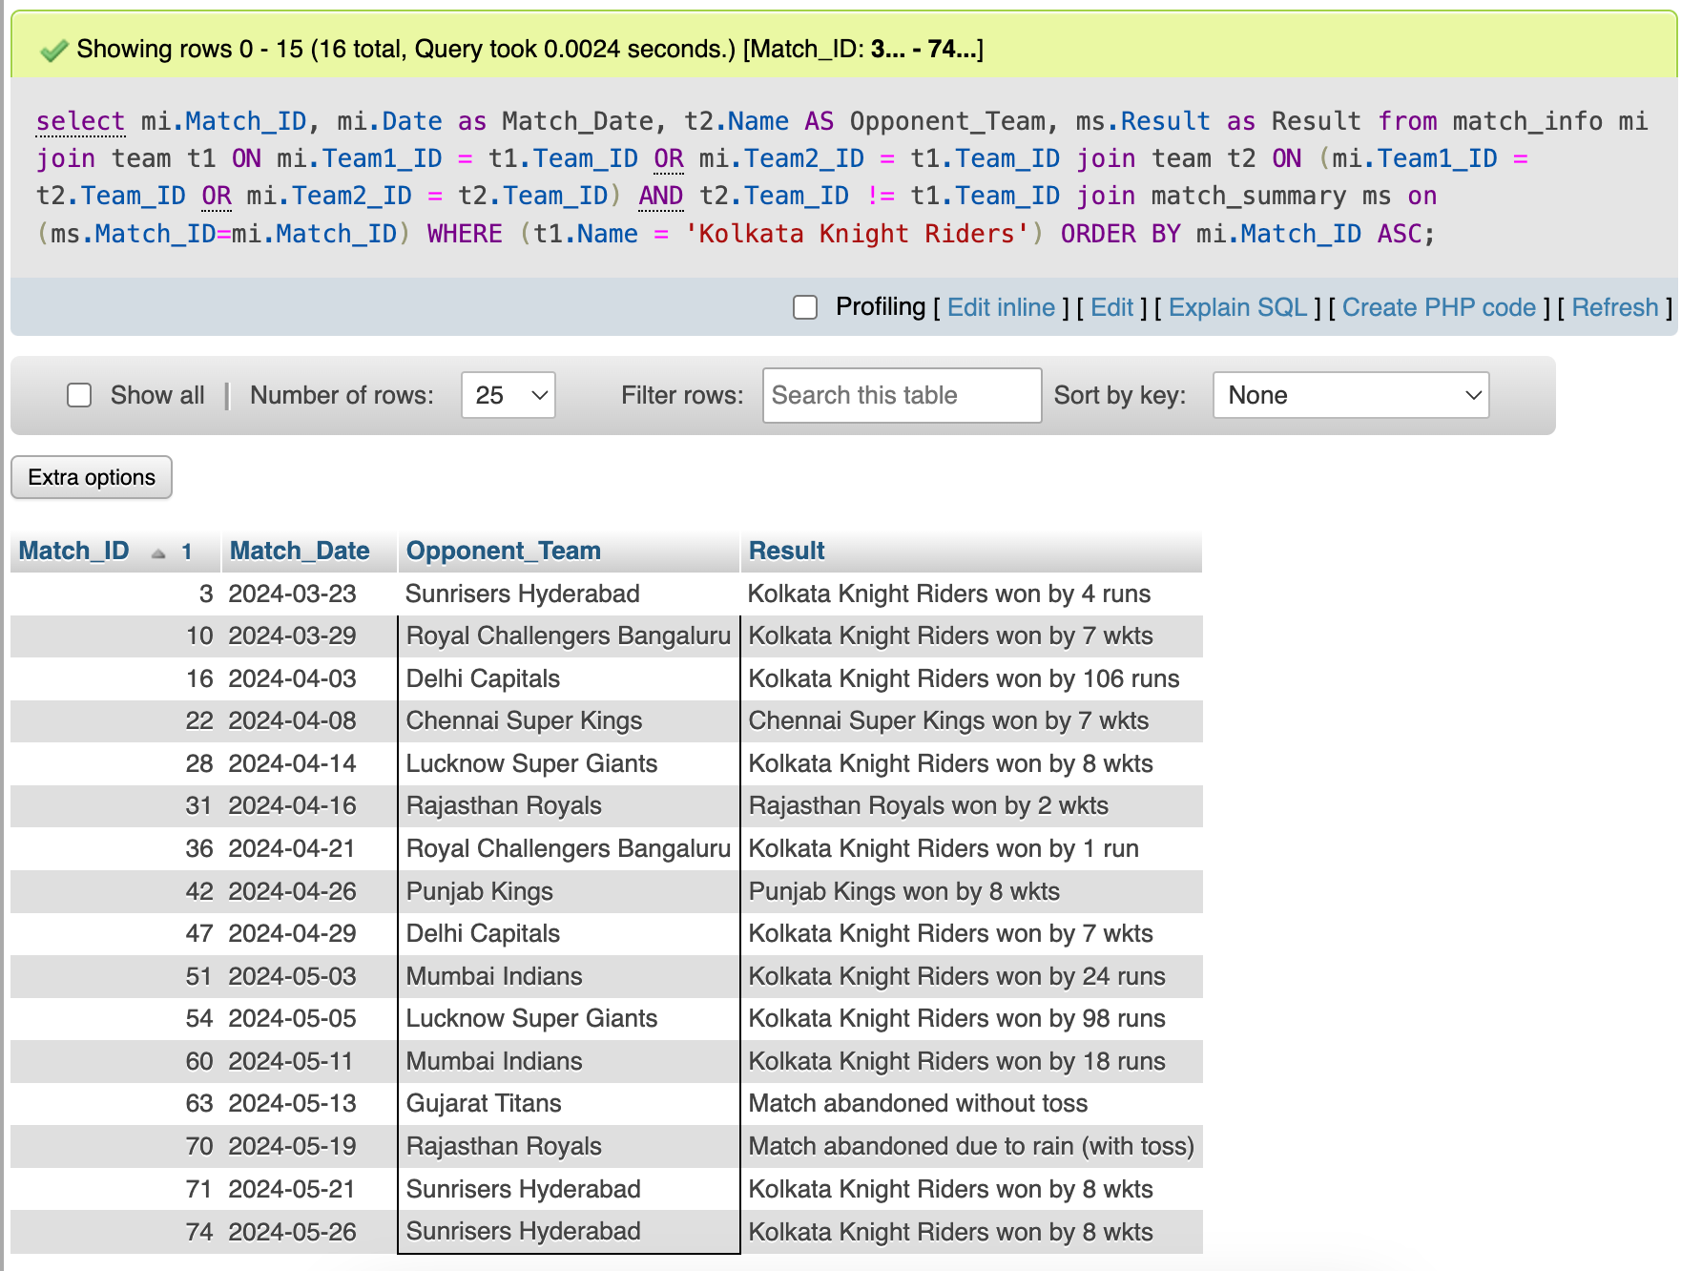
Database Operations
“Query #3”
Retrieve the match details for Kolkata Knight Riders including the date and result.
aa
SELECT mi.Match_ID, mi.Date AS Match_Date,
t2.Name AS Opponent_Team, ms.Result AS Result
FROM match_info mi
JOIN team t1 ON mi.Team1_ID = t1.Team_ID OR
mi.Team2_ID = t1.Team_ID
JOIN team t2 ON (mi.Team1_ID = t2.Team_ID OR
mi.Team2_ID = t2.Team_ID) AND
t2.Team_ID != t1.Team_ID
JOIN match_summary ms ON (ms.Match_ID = mi.Match_ID)
WHERE (t1.Name = 'Kolkata Knight Riders’)
ORDER BY mi.Match_ID ASC;

Slide 11
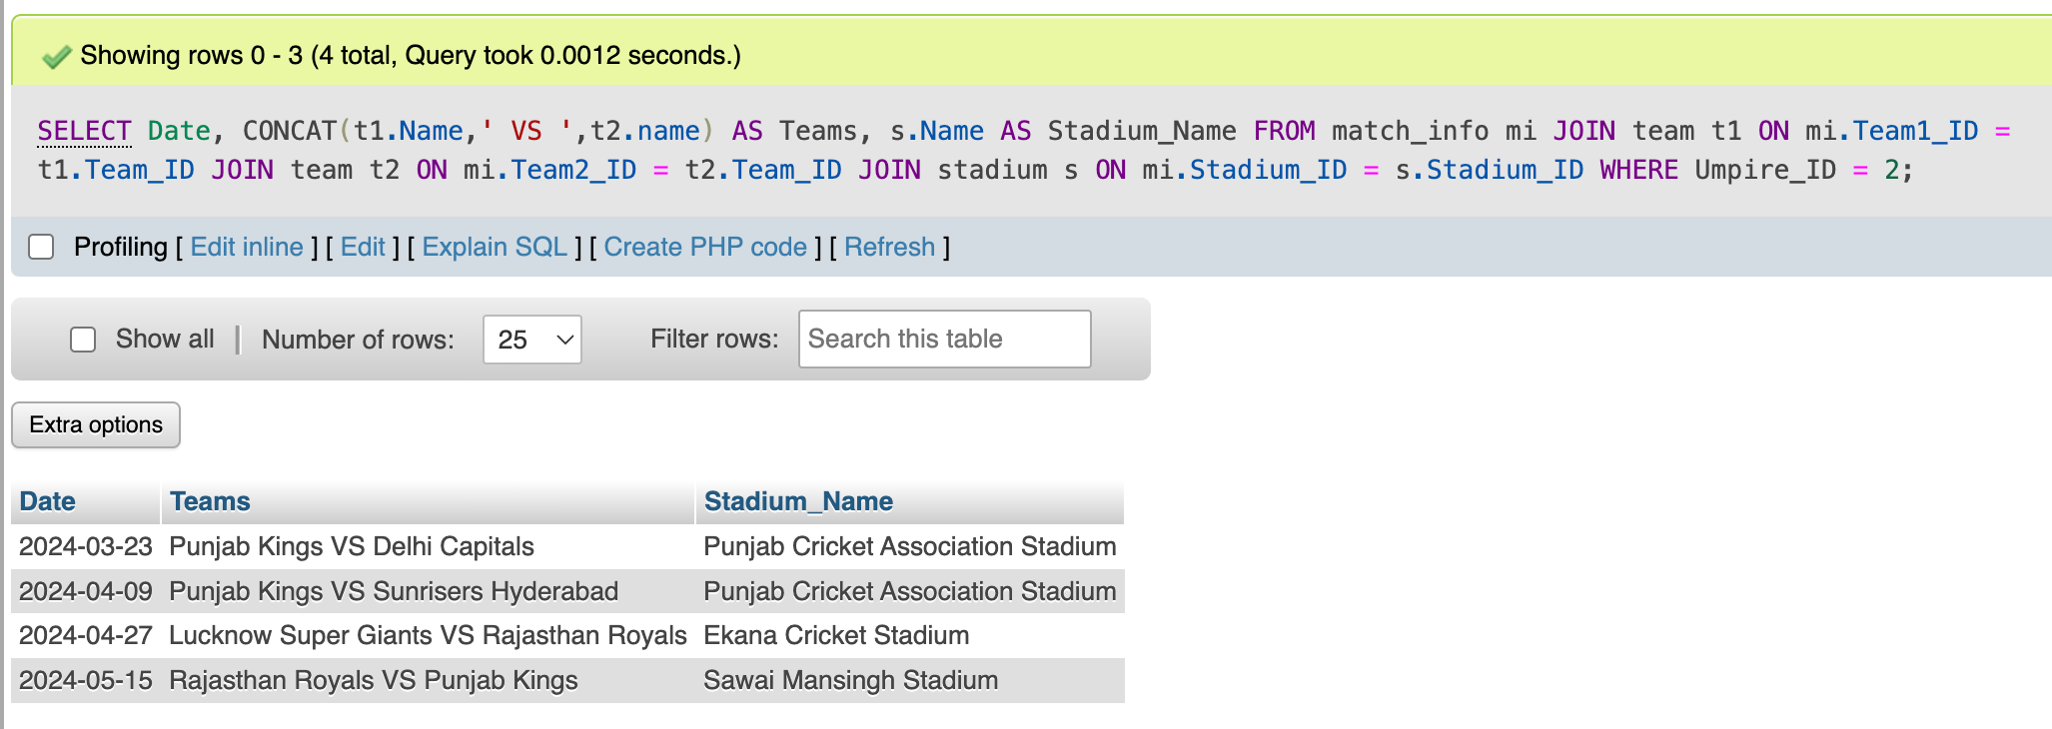
Database Operations
“Query #4”
Retrieve the info (dates, Teams, Stadiums) for matches officiated by a specific Umpire.
SELECT Date, CONCAT(t1.Name,' VS ',t2.name) AS Teams, s.Name AS Stadium_Name
FROM match_info mi
JOIN team t1 ON mi.Team1_ID = t1.Team_ID JOIN team t2 ON mi.Team2_ID = t2.Team_ID
JOIN stadium s ON mi.Stadium_ID = s.Stadium_ID
WHERE Umpire_ID = 2; -- Nitin Menon

Slide 12
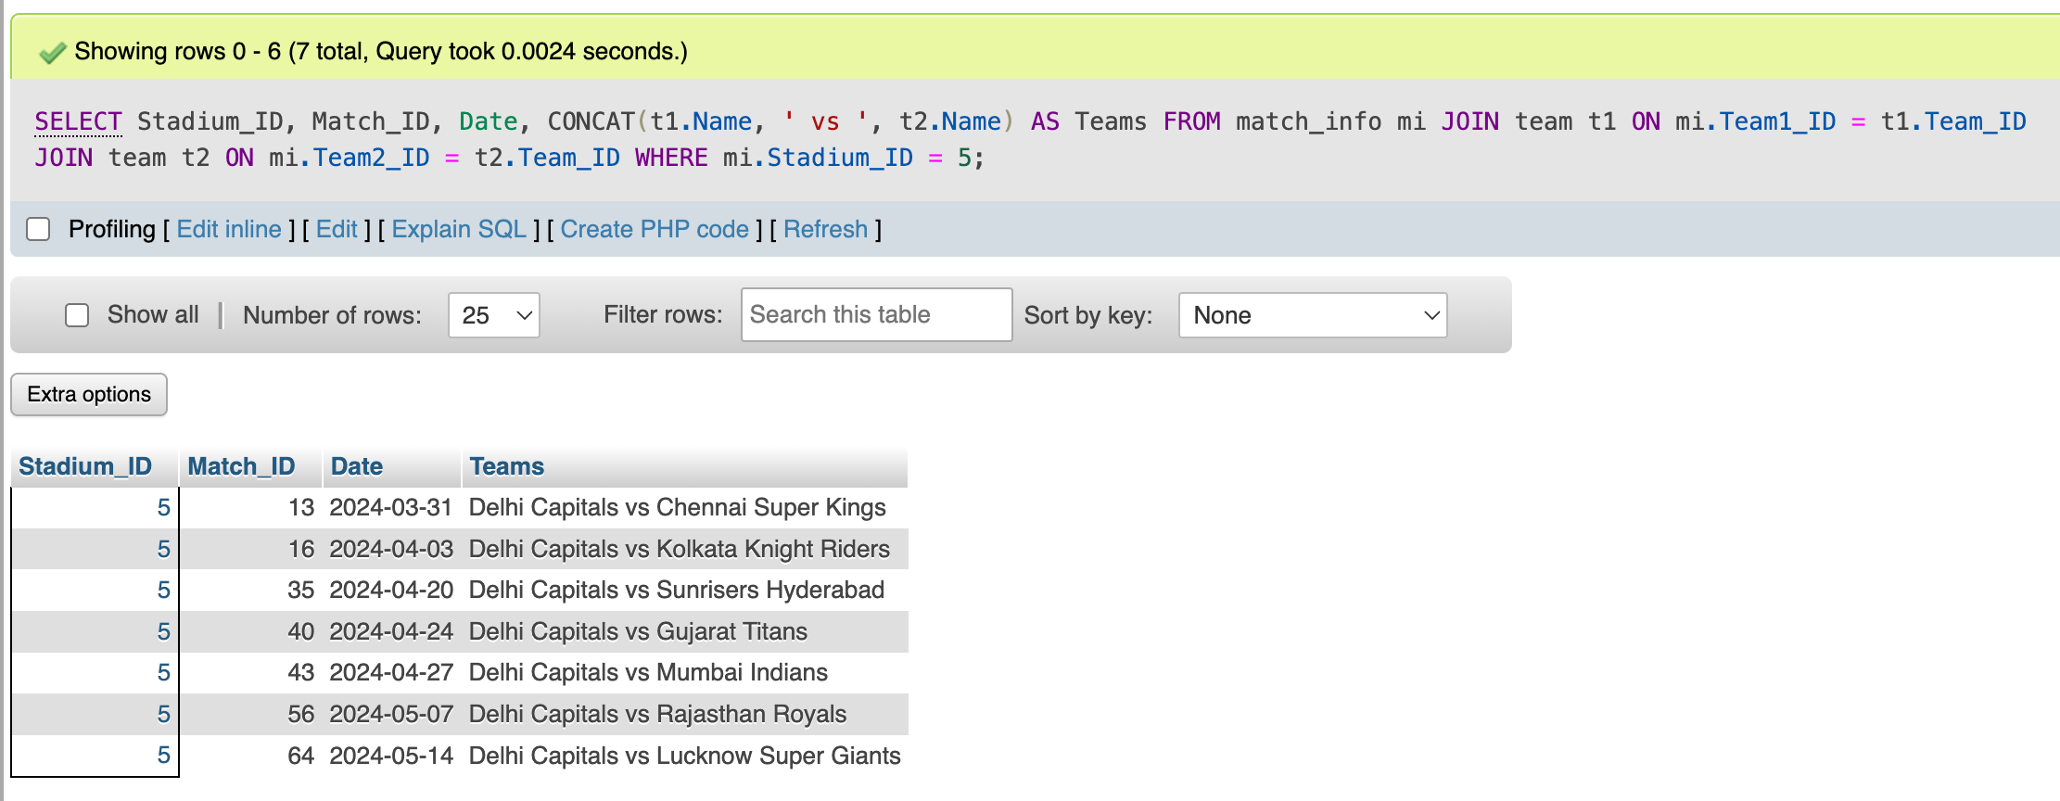
Database Operations
“Query #5”
List all matches played in a specific stadium along with the participating teams and the match date.
SELECT Stadium_ID, Match_ID, Date, CONCAT(t1.Name, ' vs ', t2.Name) AS Teams
FROM match_info mi
JOIN team t1 ON mi.Team1_ID = t1.Team_ID JOIN team t2 ON mi.Team2_ID = t2.Team_ID
WHERE mi.Stadium_ID = 5; -- Arun Jaitley Stadium

Slide 13
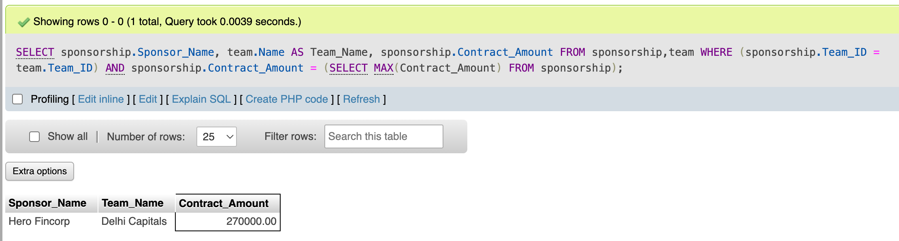
Database Operations
“Query #6”
Retrieve the sponsor who has contracted the highest among all the sponsors.
SELECT sponsorship.Sponsor_Name, team.Name AS Team_Name, sponsorship.Contract_Amount
FROM sponsorship, team
WHERE (sponsorship.Team_ID = team.Team_ID) AND
sponsorship.Contract_Amount = (SELECT MAX(Contract_Amount)
FROM sponsorship);

Slide 14
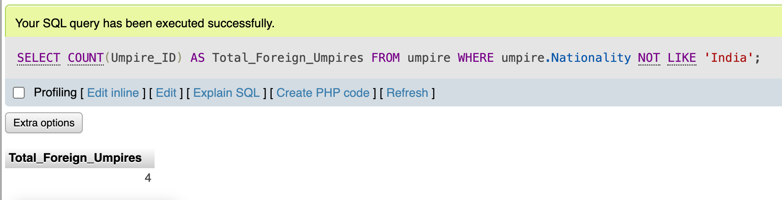
Database Operations
“Query #7”
How many foreign umpires are here in this IPL?
SELECT COUNT(Umpire_ID) AS Total_Foreign_Umpires
FROM umpire
WHERE umpire.Nationality NOT LIKE 'India’;

Slide 15
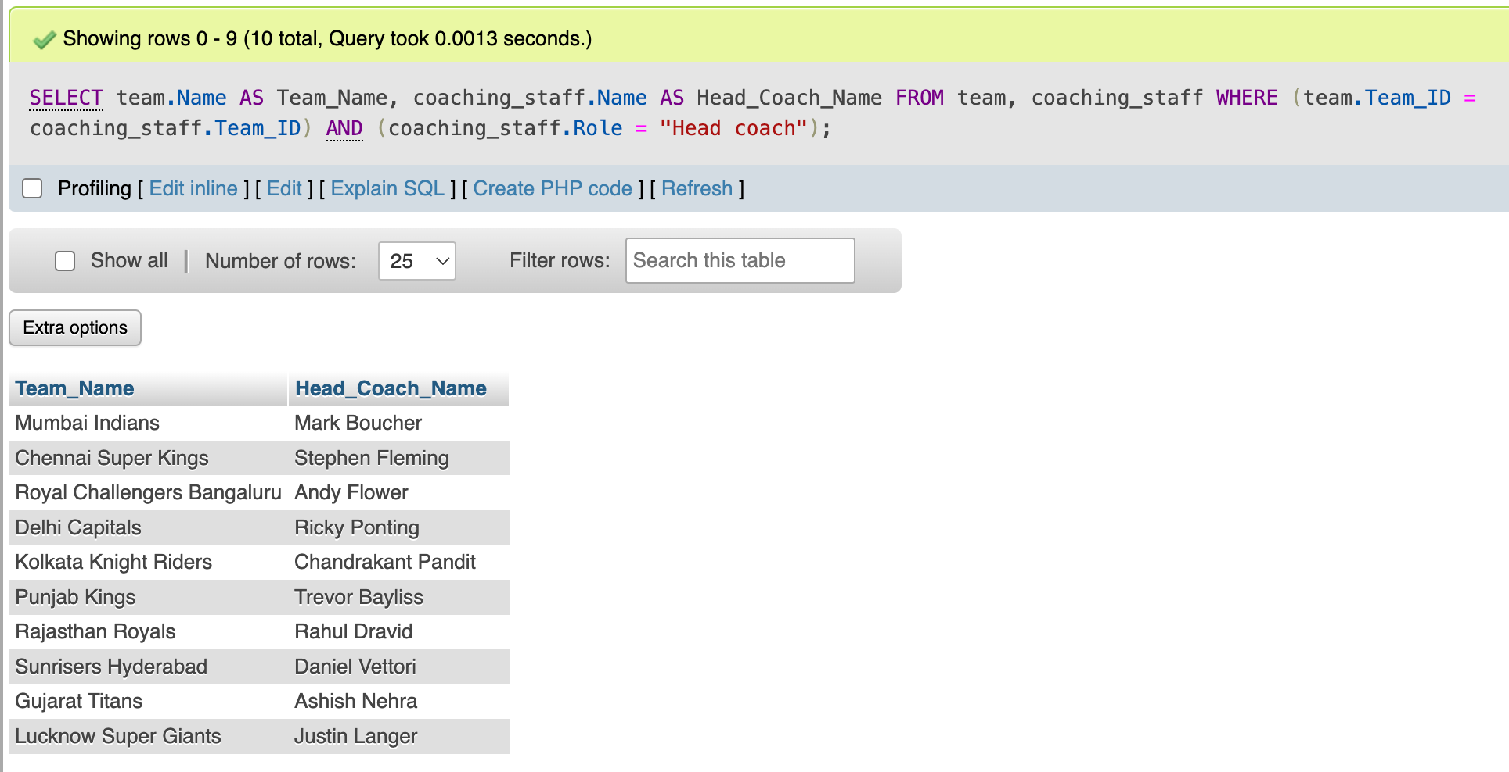
Database Operations
“Query #8”
Write down the name of head coach for all teams?
SELECT team.Name AS Team_Name, coaching_staff.Name AS Head_Coach_Name
FROM team, coaching_staff
WHERE (team.Team_ID = coaching_staff.Team_ID) AND (coaching_staff.Role = "Head coach");

Slide 16
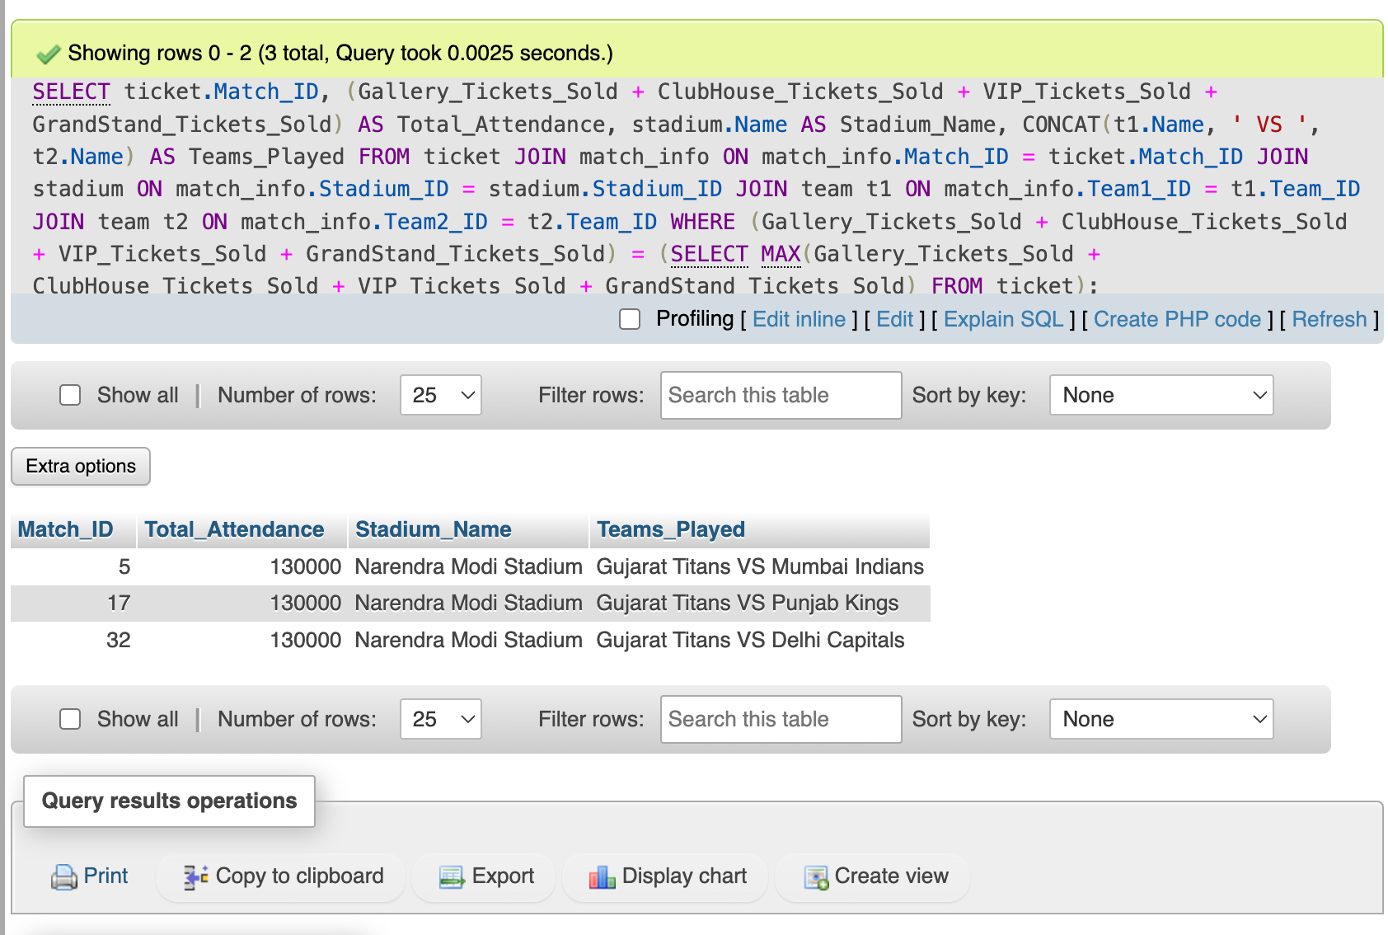
Database Operations
“Query #9”
Which match has the highest attendance?
aa
SELECT ticket.Match_ID,
(Gallery_Tickets_Sold+ClubHouse_Tickets_Sold+VIP_Tickets_Sold+
GrandStand_Tickets_Sold) AS Total_Attendance,
stadium.Name AS Stadium_Name,
CONCAT(t1.Name, ' VS ', t2.Name) AS Teams_Played
FROM ticket
JOIN match_info ON match_info.Match_ID = ticket.Match_ID
JOIN stadium ON match_info.Stadium_ID = stadium.Stadium_ID
JOIN team t1 ON match_info.Team1_ID = t1.Team_ID
JOIN team t2 ON match_info.Team2_ID = t2.Team_ID
WHERE (Gallery_Tickets_Sold+ClubHouse_Tickets_Sold+
VIP_Tickets_Sold+GrandStand_Tickets_Sold) =
(SELECT MAX(Gallery_Tickets_Sold+ClubHouse_Tickets_Sold+
VIP_Tickets_Sold+GrandStand_Tickets_Sold)
FROM ticket);

Slide 17
Database Operations
“Query #10”
Which team has scored the highest run in this IPL and against whom?
aa
SELECT match_summary. Match_ID,
CASE
WHEN Team1_Score > Team2_Score THEN Team1_Score
ELSE Team2_Score END AS Highest_Score,
CASE
WHEN match_summary.Team1_Score > match_summary.Team2_Score THEN team1.Name
ELSE team2.name END AS Scoring_Team,
CASE
WHEN match_summary.Team1_Score < match_summary.Team2_Score THEN team1.Name
ELSE team2.name END AS Opponent_Team,
stadium_name.Name AS stadium_name
FROM Match_Summary
JOIN Match_Info ON match_info.Match_ID = match_summary.Match_ID
JOIN team AS team1 ON match_info.Team1_ID = team1.Team_ID
JOIN team AS team2 ON match_info.Team2_ID = team2.Team_ID
JOIN stadium AS stadium_name ON match_info.Stadium_ID = stadium_name.Stadium_ID
ORDER BY Highest_Score DESC LIMIT 1;

Slide 18
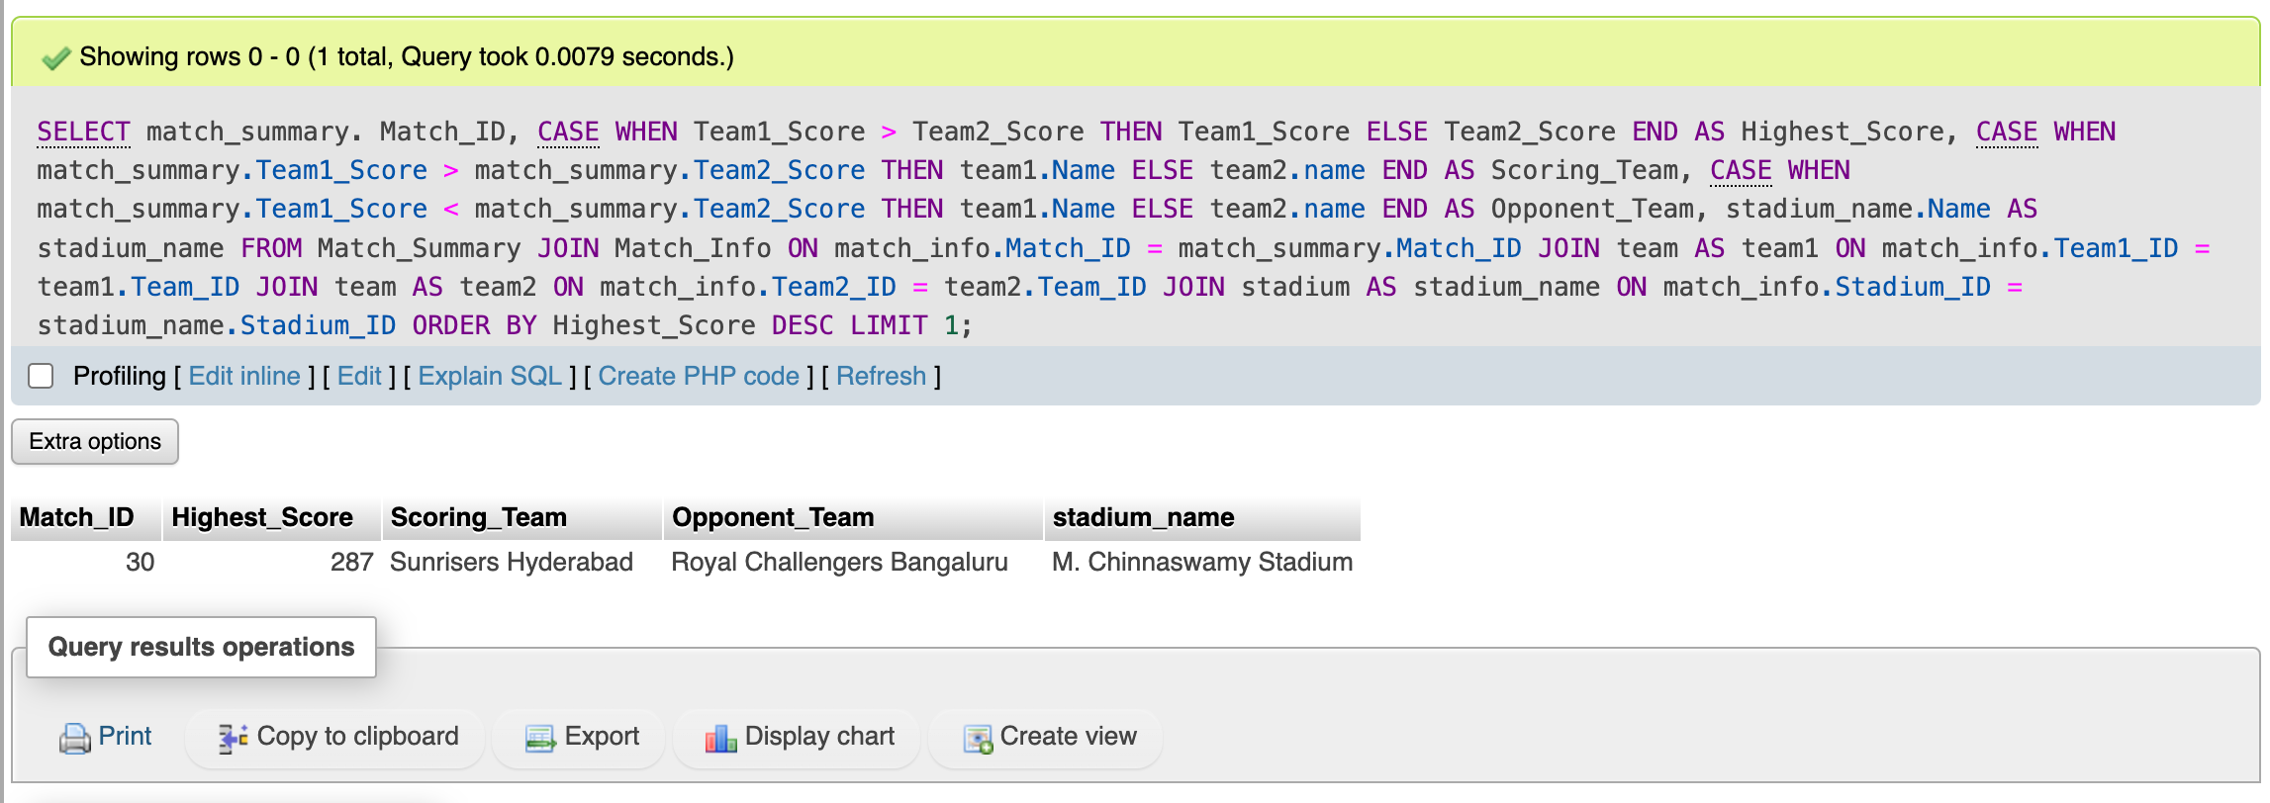
Database Operations
“Query #10”
Which team has scored the highest run in this IPL and against whom?

Slide 19

Conclusion
The IPL 2024 Database System provides an organized framework for managing tournament data. Its structured design ensures efficient operation, accurate tracking and seamless data handling, helps a lot in decision-making.

Slide 20
Thank You!
with sincere gratitude for your generosity.
Presented to
Molla Rashied Hussein
Assistant Professor, Department of CSE, UAP

Slide 21



CREDITS
All the current updates has been collected from

Slide 22
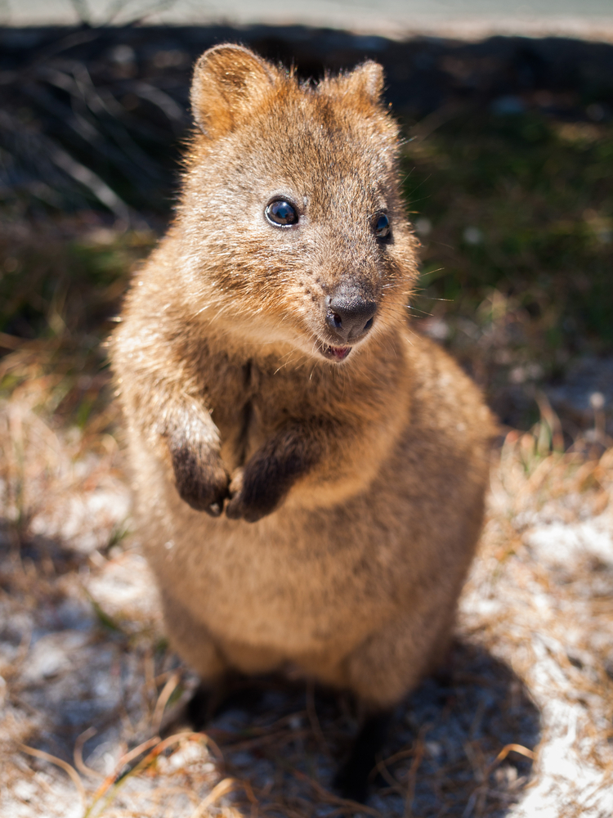

Quokka
The quokka is a small macropod about the size of a domestic cat.
Quokka is the Happiest Animal on the planet.
Explore Me!
<< Go back

